Slide 1


RSO Training

Slide 2
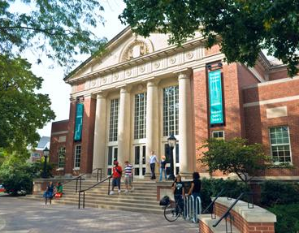
THE OFFICE OF STUDENT INVOLVEMENT
Student Activities
  Campus Activities Board
  Evening & Weekend Programming
  Signature Programs
Hansen Student Center
Registered Student Organizations
  Student Senate
Intramurals
Leadership
  Do Good Leadership Series
Fraternity and Sorority Life
  Interfraternity Council
  College Panhellenic Council
  Fraternity & Sorority Programming Board
Hansen Student Center
Suite 101
getinvolved@iwu.edu

Slide 3
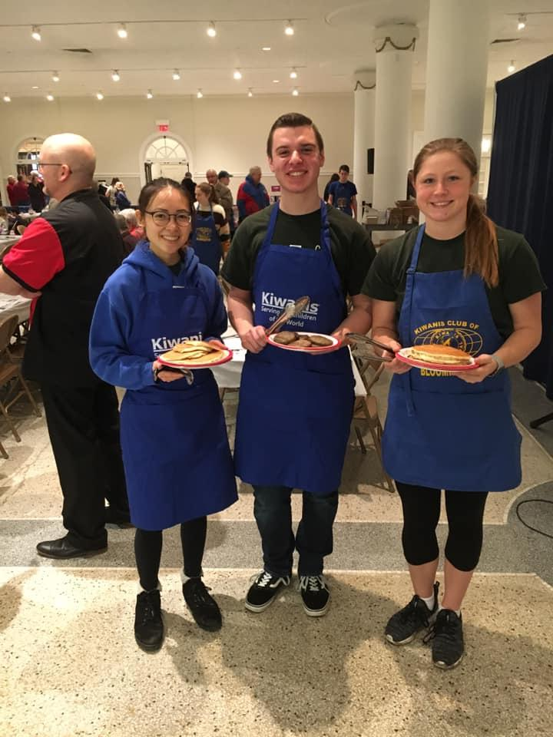
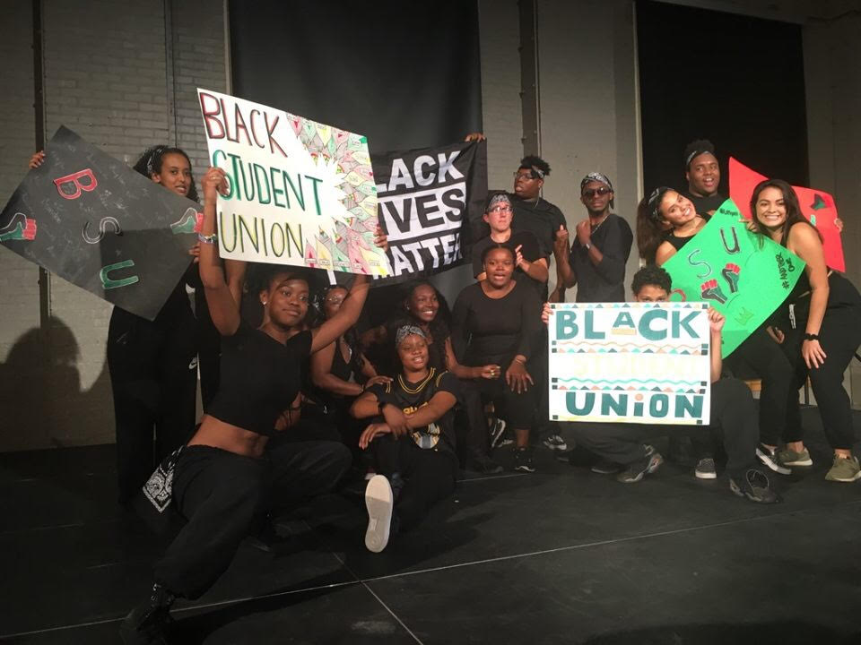
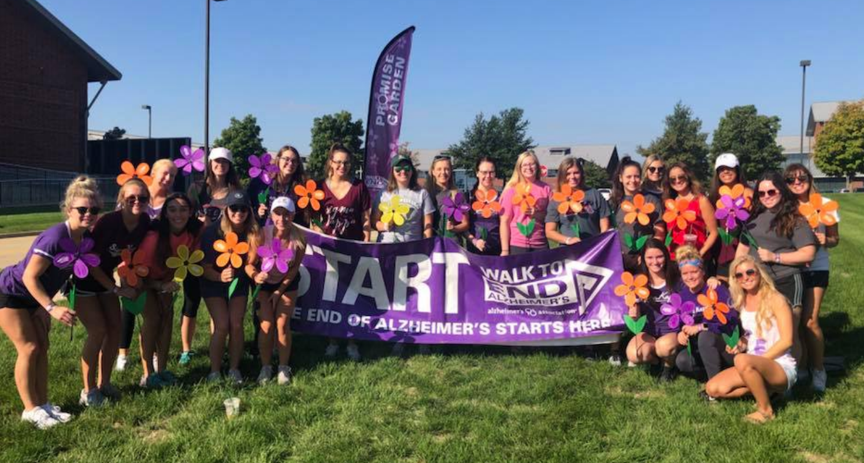
REGISTERED STUDENT ORGANIZATIONS
& THE IWU MISSION

Slide 4
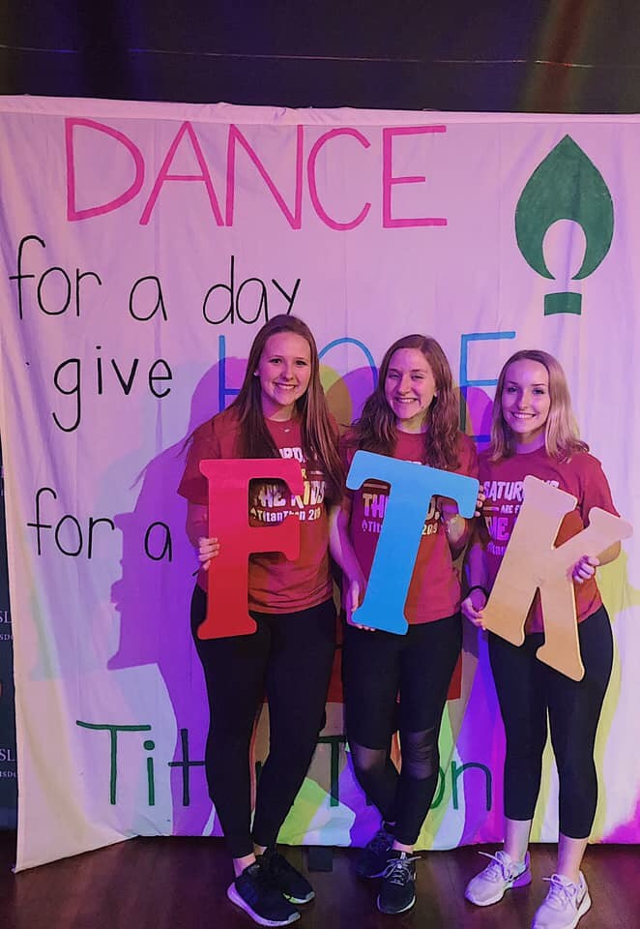
RSO POLICIES & PROCEDURES
Faculty/Staff Advisors
Executive Board
Mission & Purpose Statement
Need a waiver for an event? Come see our office!

Slide 5
RSO POLICIES & PROCEDURES:
STUDENT HANDBOOK
RSOs and Students are to abide by the Student Handbook
  Anti-Hazing Policy
  Alcohol & Substance Use Policy

Slide 6
RSO POLICIES & PROCEDURES:
UNIVERSITY VEHICLE DRIVING POLICY
Prior to driving any University owned or leased vehicle all students, staff, and faculty need to complete an MVR authorization form. The form must be submitted to the Campus Safety office at least one week prior to the date of travel. As soon as the MVR is obtained and evaluated, the driver will be notified if they will or will not be permitted to operate the University owned or leased vehicle.
If a student, faculty, or staff member wishes to use their own vehicle to transport other students, faculty, or staff in their personal vehicle, they must submit an MVR authorization form and be approved prior to transporting any students, faculty, or staff.
No one under 20 years of age will be permitted to drive any University owned or leased vehicle, or transport other students, faculty, or staff on University sanctioned or sponsored events.
Anyone wishing to drive a University owned or leased van or shuttle must also complete and pass an on-line van safety course. The test is administered through the Campus Safety Office.

Slide 7
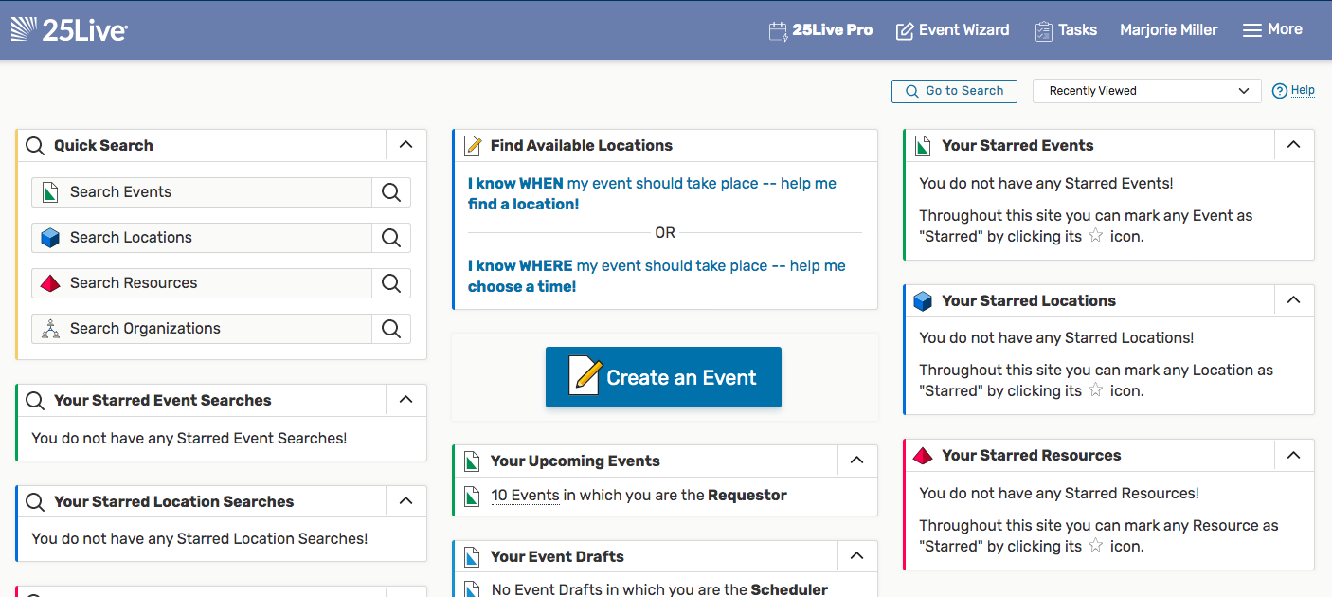
25 LIVE
https://25live.collegenet.com/pro/iwu#!/home/dash

Slide 8
INITIAL GOALS FOR YOUR RSO
Meeting Schedule
  What type of schedule will you follow and communicate to your membership?
Recruitment & Retention
  How will you continue to engage your members to ensure they are retained?
Semester Goals
  What are three small goals you would like to accomplish this semester?

Slide 9
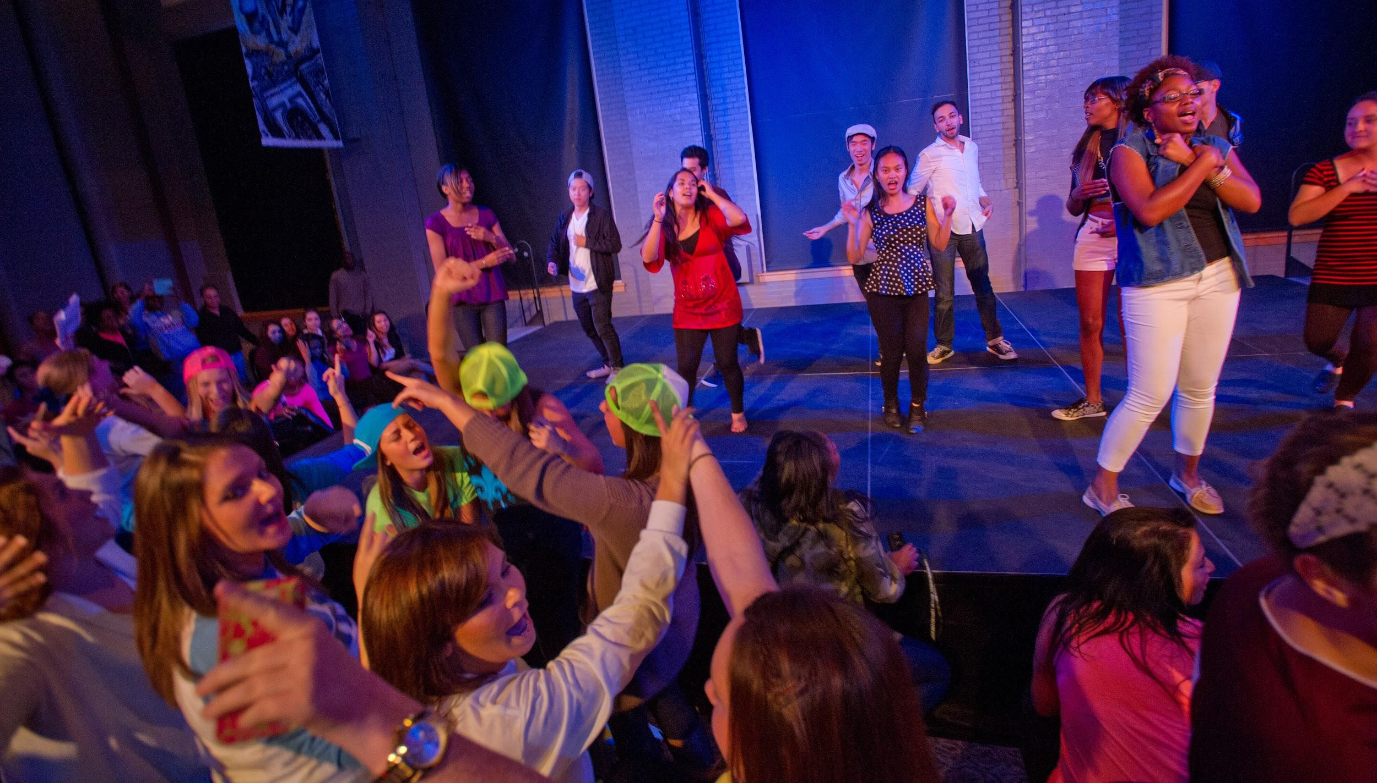
GETINVOLVED@IWU.EDU

